Slide 1
Self-employment Trajectories: A Sequence Analysis
18.04.2024
Jannes, Xingting & Lea
Applied Longitudinal Data Analysis

Slide 2
Expectations
We expect some individuals to be more consistently self-employed while others switch between self-employment and other forms of employment in Germany.
Men are more likely to be self-employed compared to women in Germany.

Slide 3
Variable Decisions
Employment, three categories:
Self-emplyoment
Employment (part-time or full-time)
Unemployment (not-working/unemployed)

Slide 4
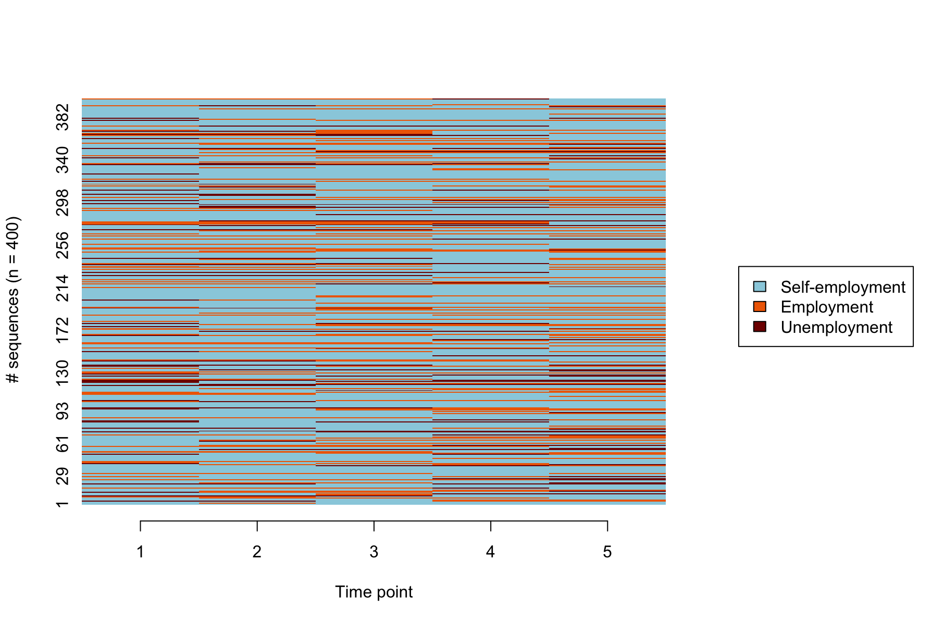
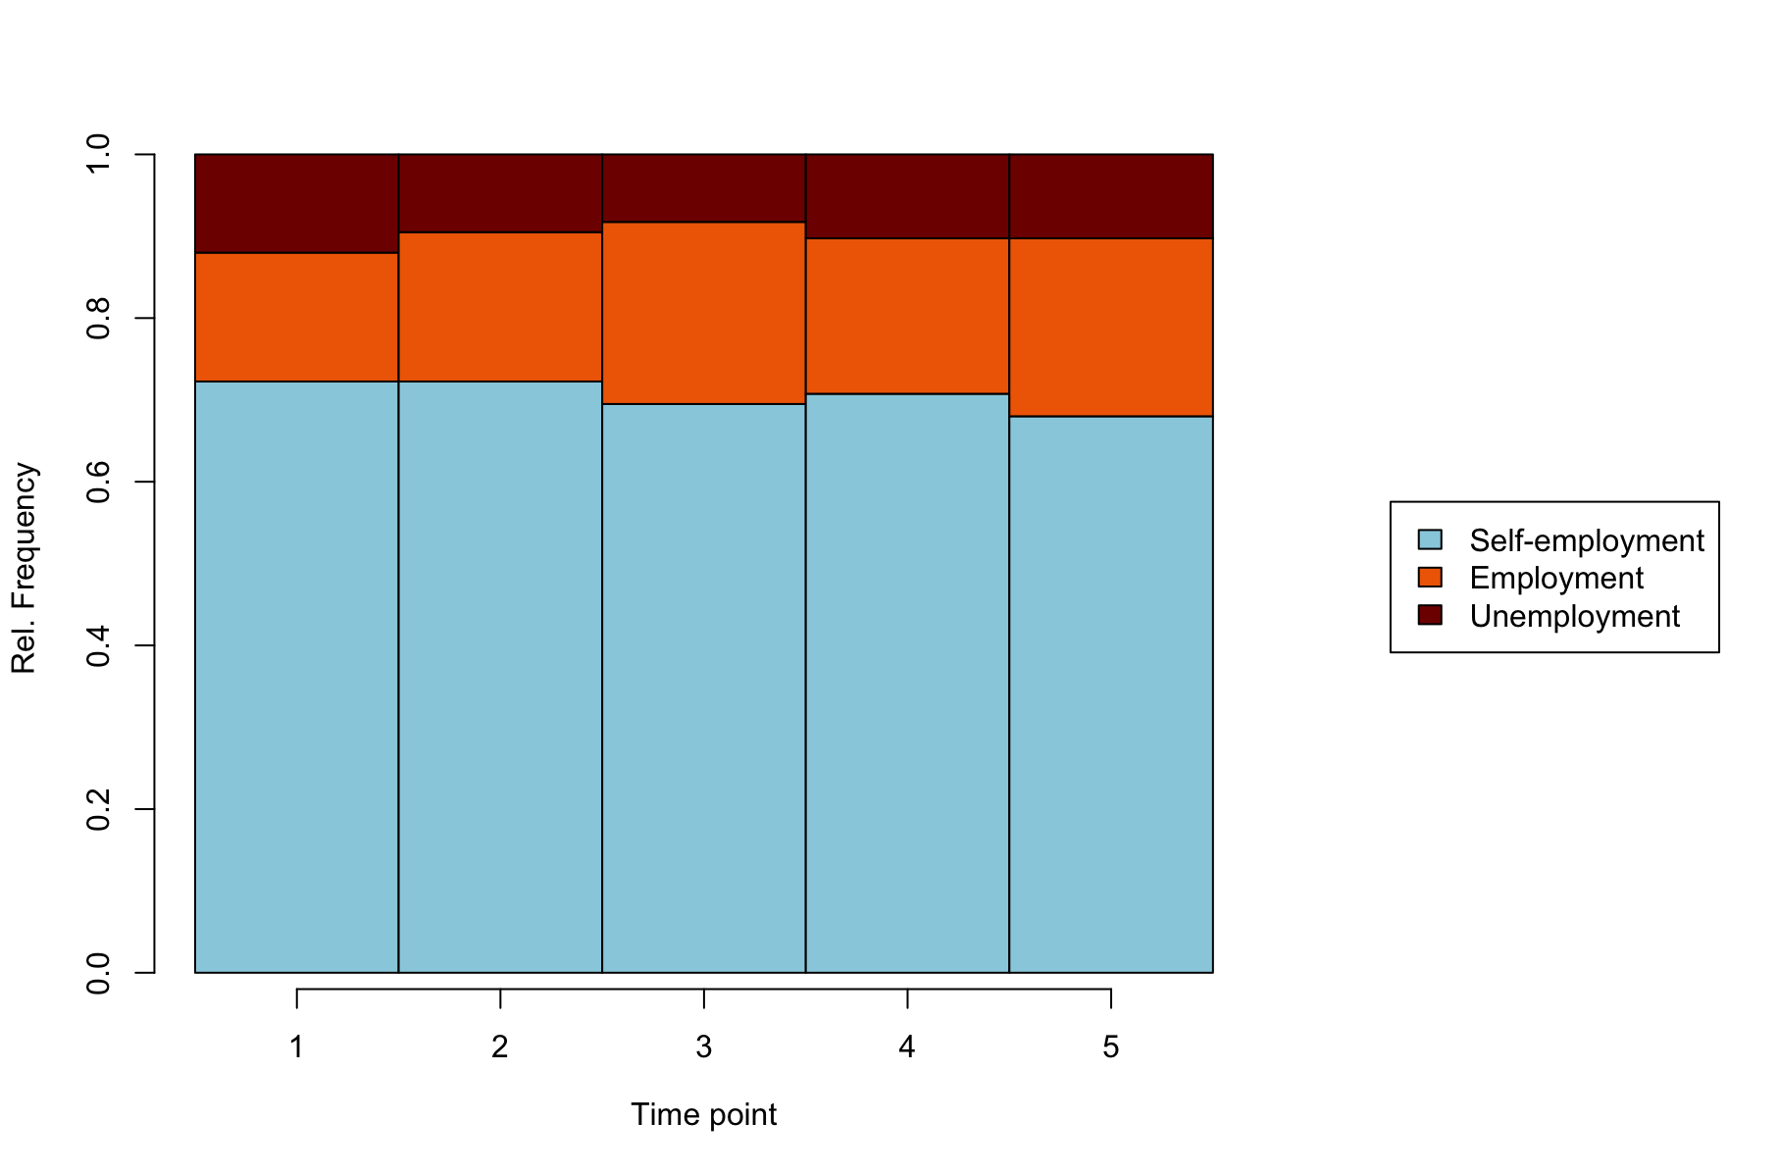
Plotting the Sequence
Figure 1: Index Plot, Self-employment trajectories for the years 2016-2020
Figure 2: Frequency Plot, Self-employment trajectories for the years 2016-2020
DATA: SOEP
DATA: SOEP

Slide 5
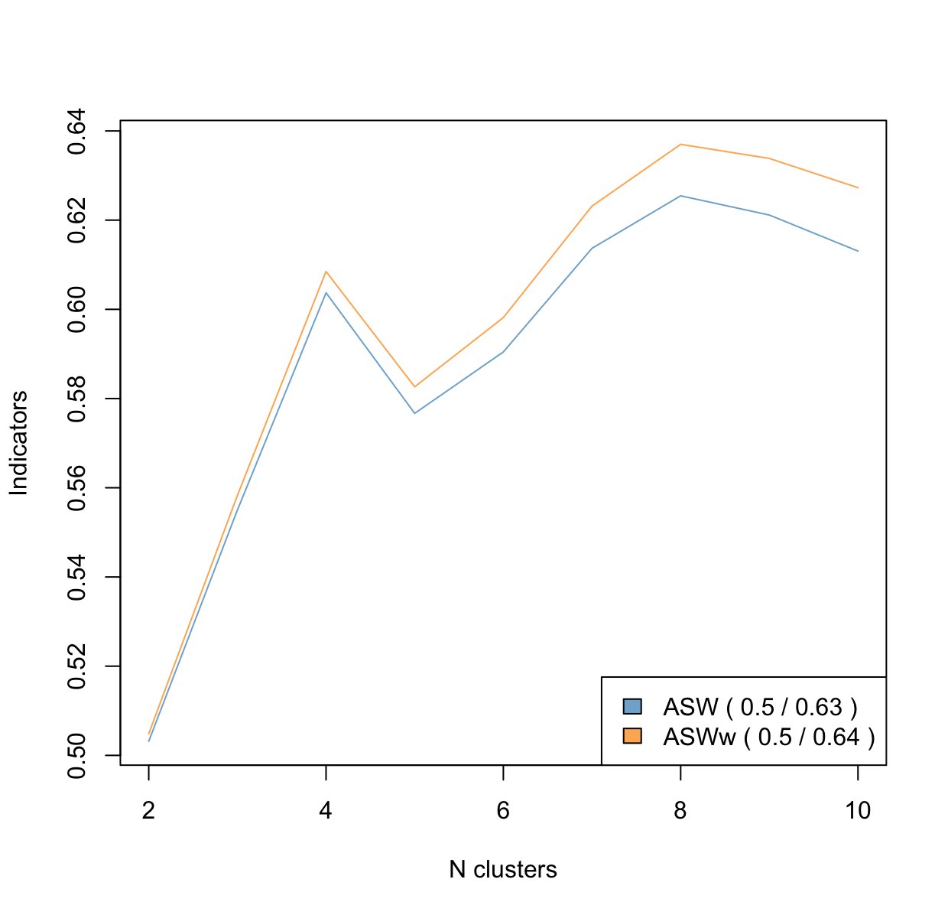
Choosing the Optimal Number of Clusters
Figure 3: Plotting of Potential Clusters, using ASW

Slide 6
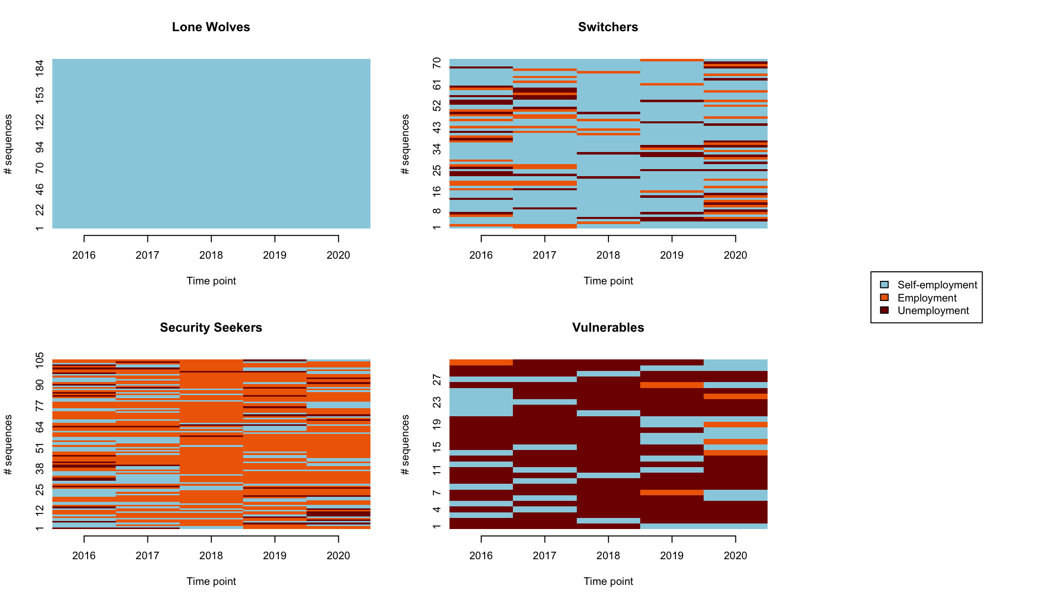
Plotting and Naming our Clusters – 1
Figure 4: Sequence Plot for the four Clusters
Data Source: SOEP

Slide 7
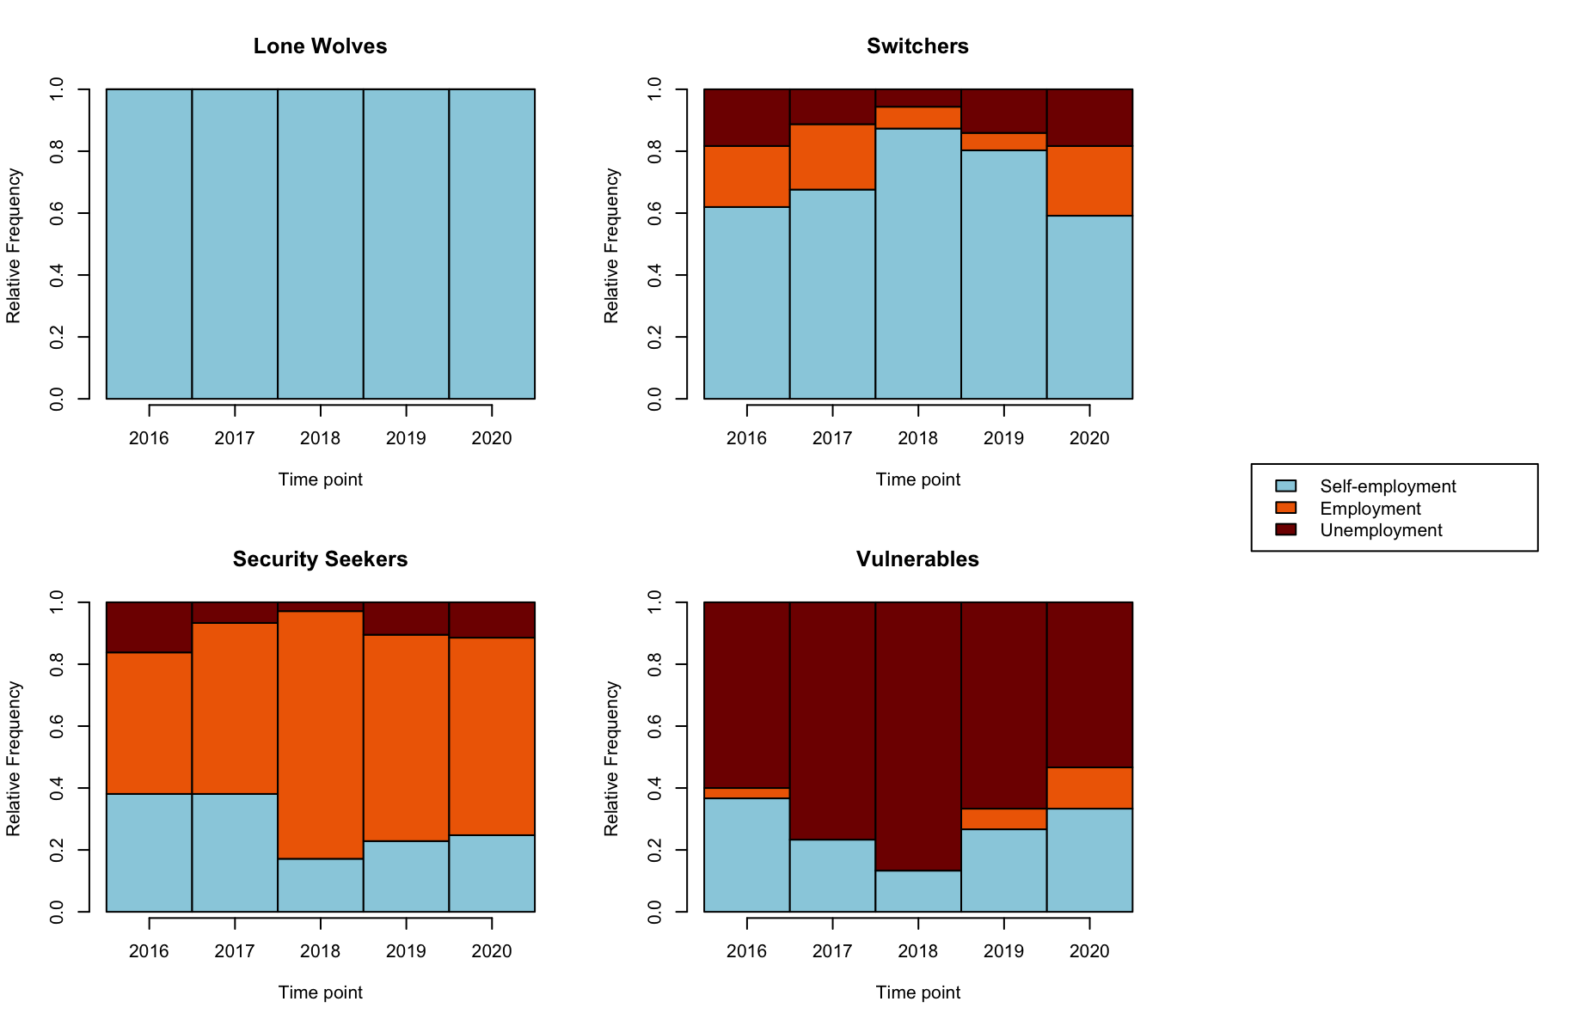
Plotting our Clusters – 2
Figure 5: Frequency Plot for the four Clusters
Data Source: SOEP

Slide 8
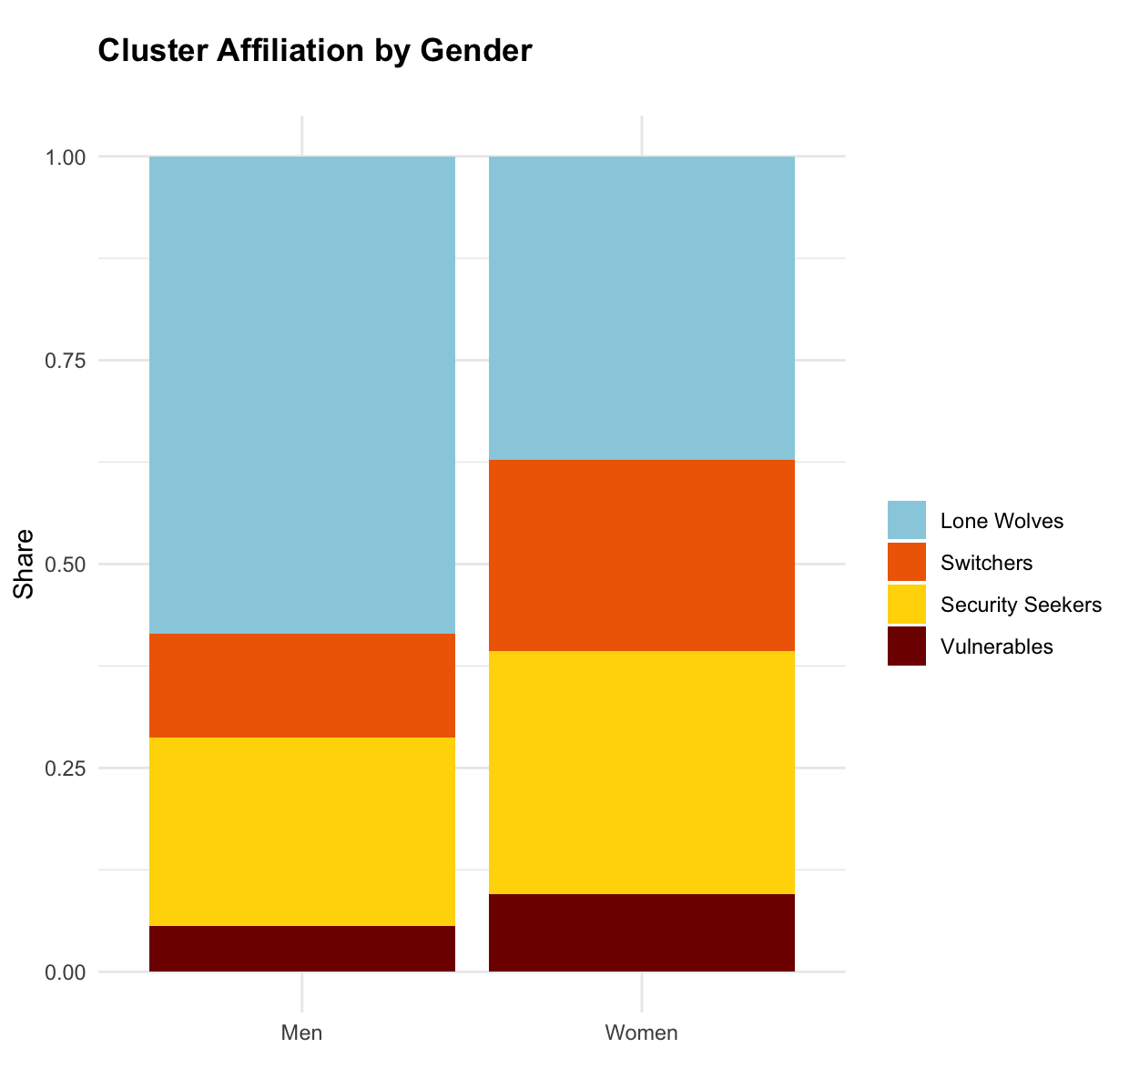
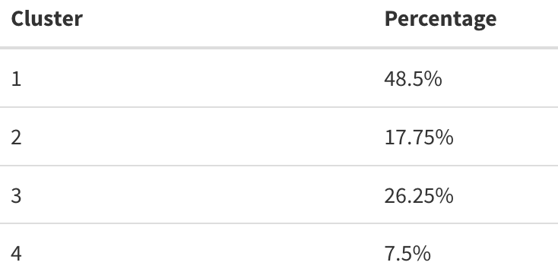
Description of the Clusters
Figure 6: Cluster Affiliation by Gender (four clusters)
Table 1: Percentage in each cluster based on the longest common subsequence as distance measure.
DATA: SOEP

Slide 9
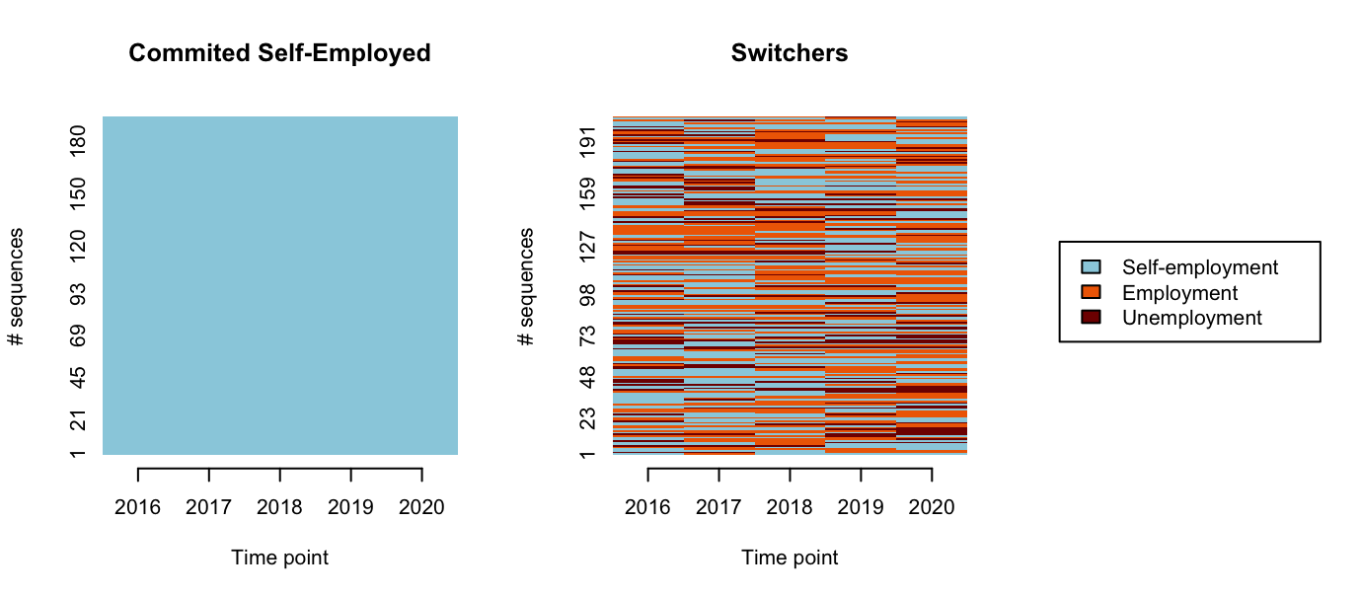
Changing to 2 Clusters for the Logit Model
Figure 7: Self-employment trajectories for the years 2016-2020, Sequence Plot, two clusters
Data Source: SOEP

Slide 10
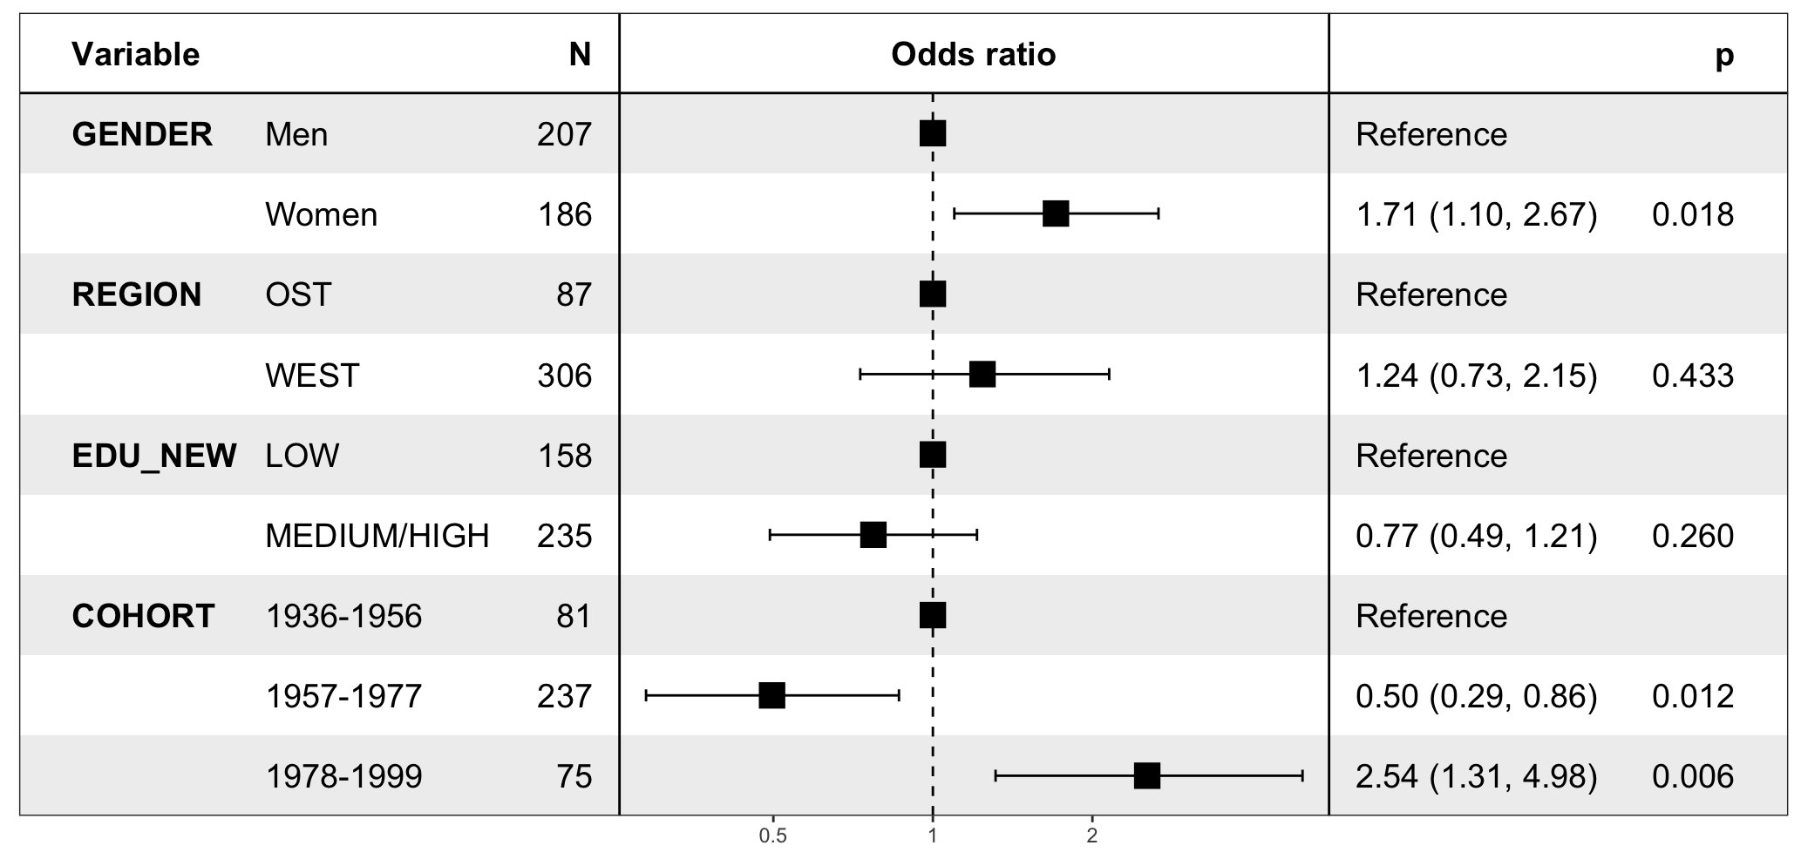
Forest Plot
Figure 8: Results from Logit Midel:
0: Commited Self-Employed 1: Switchers
Data Source: SOEP

